Slide 1
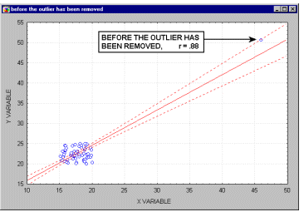
Check for outliers
outliers have a profound influence on the slope of the regression line and consequently on the value of the correlation coefficient

Slide 2
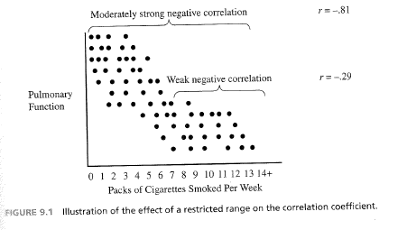

Slide 3
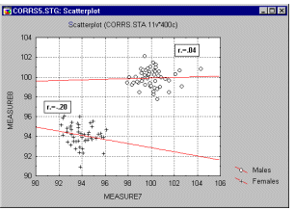
a high correlation may result that is entirely due to the arrangement of two ‘subset’ groups, but which does not represent the "true" relation between the two variables,

